Slide 1
  Chapter Two
  Microprocessor Architecture

Slide 2
Outline
  Features of 8085 Microprocessor & PIN Diagram 0f 8085 Microprocessor
  Address Bus & Multiplexed Address / Data Bus Control and status signals
  Power-supply and clock frequency
  Externally initiated signals including Interrupts Serial I/O Ports
  8085 BUS organization and 8085 registers
  Microprocessor operations: Microprocessor initiated Operations, Internal data operations, Externally Initiated operations
  Microprocessor Communication & Bus Timings De-multiplexing
  Generating Control Signals 8085 Machine Cycles & Bus Timings Opcode Fetch Machine Cycle, Memory Read Machine Cycle E.g., of an 8085 based microcomputer .

Slide 3
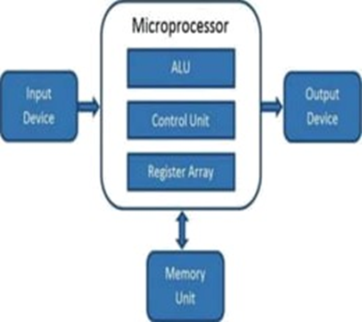
Introduction
What is a Microprocessor?
A microprocessor is the central Processing Unit of a computer that has been constructed one single chip.
It is an integrated circuit and is able to implement all the important functions of the CPU.
It is built from a silicon chip and operates based on a clock driven to ensure synchronized processing
It accepts binary data and produces the necessary output after processing the data on the basis of the instructions which are stored in the memory.

Slide 4
What is Microprocessor - 8085 Architecture?
8085 is pronounced as "eighty-eighty-five" microprocessor.
the 8085 is an 8-bit microprocessor, and it was launched by the Intel team in the year of 1977 using NMOS technology .
Features Of 8085
  8-bit (data bus) general purpose µp
  Address bus-16 bit,
  Program counter-16-bit,
  Stack pointer-16 bit, registers 8-bit,
  Capable of addressing 64 k of memory
  Requires +5 v power supply
  Can operate with 3 MHz clock
  8085 upward compatible

Slide 5
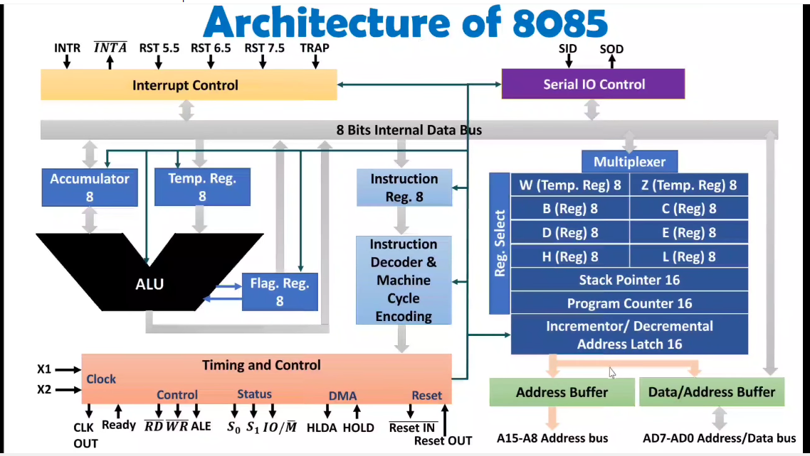
What is Microprocessor - 8085 Architecture?
The architecture of the 8085 microprocessor mainly includes the timing & control unit, Arithmetic and logic unit, decoder, instruction register, interrupt control, a register array, serial input/output control.

Slide 6
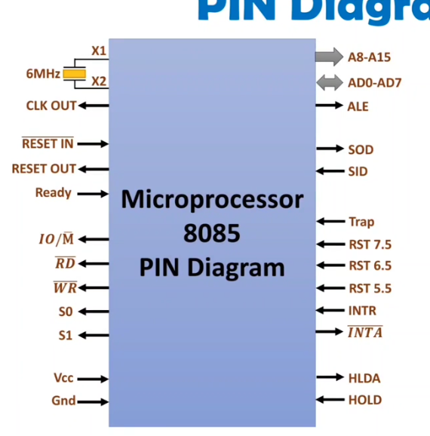
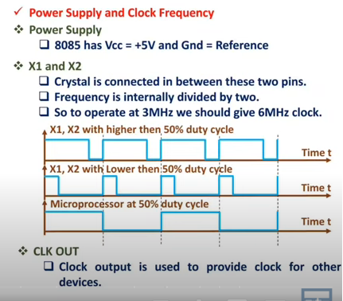
Pin Diagram of 8085

Slide 7
Cntd…
Data Bus
the data bus pins which are AD0 – AD7, this carries the minimal considerable 8-bit data and address bus.
Address Bus
The address bus carries the address which are A8 – A15,
this carries the most considerable 8-bit address bus.
Status and the Control Signals
In order to find out the behavior of the operation, these signals are mainly considered.
In the 8085 devices, there are 3 control and status signals.
RD – This control signal manages read operation. When active low (RD = 0), signifies the microprocessor read data from memory or I/O devices
WR – This control signal manages write operation. When active low( WR=0) signifies that the data bus information is written to the memory or I/O devices.

Slide 8
Cntd…
  ALE: ALE corresponds to Address Latch Enable signal.
    It's a control signal that enables or disables the address bus
    The ALE signal is high at the time of the machine’s initial clock cycle and this enables the last 8 bits of the address bus to get latched with the memory or external latch.
  IO/M: this status signal indicates whether the operation is related to memory or an I/O device.
    IO/M = 0 →microprocessor is interacting with memory.
    IO/M = 1 →microprocessor is interacting with I/O.
    S1 and S0 → two status signals (S1 and S0) work together to indicate the type of operation currently being performed by the microprocessor.
    The combination of high (1) and low (0) signals provides information about whether the operation is a fetch, memory read, memory write, I/O read, or I/O write.
    S0 and S1 pins – These pins are the status signals which defines the below operations and those are:

Slide 9
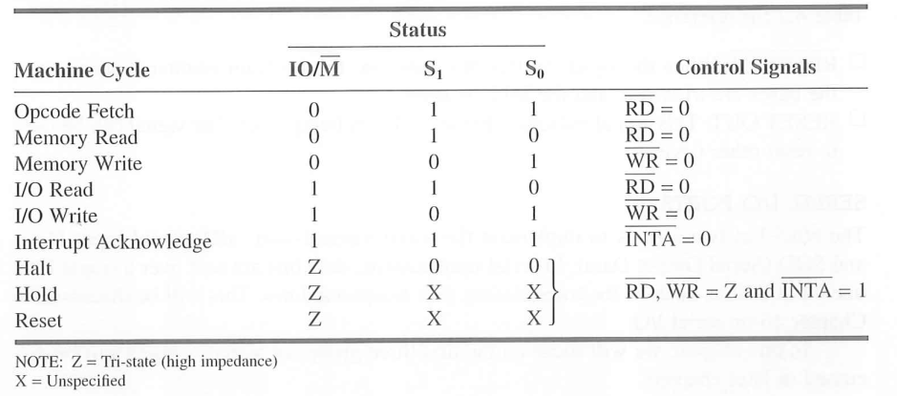
Cntd…
Reset Signals
There are two reset pins which are Reset In and Reset Out
RESET IN – This pin signifies resetting the program counter to zero. Also, this pin resets the HLDA flip-flops
    The buses are in tri state and the MPU is reset
RESET OUT : indicates the MPU is being reset and the signal can be used to reset other devices

Slide 10
Cntd…
Serial Input/Output Signals
SID: this signal represents the serial input data line.
  The information received on this line is stored in the 7th bit of the accumulator (ACC).
SOD: This signal represents the serial output data line.
The output on this corresponds to the value stored in the 7th bit of the accumulator (ACC).
Externally Initiated and Interrupts Signals
HOLD: This is an input pin that indicates another device needs to use the data and address buses.
  when the microprocessor gets a HOLD request signal, it finishes its current operation cycle and then releases control of the system buses
HLDA (Hold Acknowledge): This is an output pin that signifies the acknowledgment of the HOLD request. It goes low when the HOLD request is released.
INTA (Interrupt Acknowledge): This is an output pin used by the microprocessor to acknowledge the receipt of an interrupt request (INTR).

Slide 11
Cntd…
INTR : This is the interrupt request signal. It has minimal priority when compared with other interrupt signals.
TRAP, RST 5.5, 6.5, 7.5 These all are the input interrupt pins.
When any one of the interrupt pins are recognized, then the next signal has functioned from the constant position in the memory based on the below table:
The priority list of these interrupt signals is
  TRAP – Highest
  RST 7.5 – High
  RST 6.5 – Medium
  RST 5.5 – Low
  INTR – Lowest

Slide 12
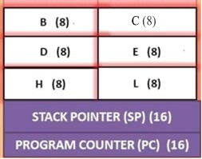
Cntd…
A. Register Array : It has eight addressable 8-bit register: A, B, C, D, E, H, L, F and two 16 bit register PC and Sp.
These registers can be classified as:
General Purpose registers
Temporary Registers
  Temporary data registers
  W and Z registers
Special purpose registers:
  Accumulator
  Flag register
  Instruction register
Sixteen bit registers:
  Program counter (PC)
  Stack pointer (SP)

Slide 13
Cntd…
i. General Purpose register
There are six general purpose registers in 8085 microprocessor
i.e. B. C. D. E. H. & L. each register can hold 8 bit data
These registers can work in pair to hold 16 bit data and their pairing combination is like , B-C, D-E & H-L
ii. Temporary registers
It is an 8 bit register associated with ALU.
It holds data during an arithmetic and logical operation
It is used by the microprocessor .
W and Z are two 8-bit temporary registers
It is not accessible to programmer

Slide 14
Cntd…
iii. Special Purpose Register
Accumulator(A):
  The accumulator is an 8 bit register associated with the ALU.
  The register “A” is an accumulator in 8085 microprocessor
  It used to hold one of the operands of arithmetic, logical and Load/Store operation
  The final result of arithmetic or logical operation is also placed in the accumulator
  Instruction register
  The instruction register holds the opcode (operation code or instruction code) of the instruction which is being decoded and executed.
  Flag Register:
  the intel 8085 microprocessor contains 8 bit register – shows the status of the microprocessor before/after an operation.

Slide 15
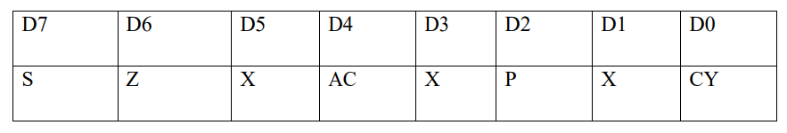
Cntd…
The five status flags of intel 8085 are:
    Carry Flag (CS)
    Parity Flag (P)
    Auxiliary Carry Flag(AC)
    Zero Flag (Z)
    Sign (S)
Carry Flag: It is set 1 if there is a carry or borrow from arithmetic operation
Parity Flag: it is set 1 if parity is even or 0 if it is odd
Auxiliary Carry Flag: it is set 1 if there is a carry out of bit from D3 to D4
Zero Flag: it is set 1 if result obtained after an operation is 0
    It is set following an increment or decrement operation of that register
Sign Flag: Used for indicating the sign of the data in the accumulator
    The sign flag is set 1 if negative (1 – negative)
    The sign flag is set 0 if positive (0 –positive)

Slide 16
Cntd…
iv. 16. Bit Register :
i. Program Counter (PC):
  It is a 16 bit special purpose register
  It used to hold the address of the memory of the next instruction to be executed.
  It keeps the track of the of the instruction in the program while they are being executed.
  The microprocessor increments the contents of the next program counter during the execution of the instruction
ii.. Stack pointer
  It is 16 bit special function register used as memory pointer
  points to the top of the stack in memory
  Works based on the LIFO
  used to store temporary data like function parameters, return addresses, and local variables

Slide 17
Cntd…
B. The Arithmetic and Logic Unit (ALU)
  ALU performs the arithmetic and logical operation
  The result of an operation is stored in Accumulator
C. Instruction Decoder and Machine Cycle encoder
Decodes the op-code stored in instruction register (IR) and establishes the sequence of the events follows.
Encodes it transfer to the timing and control unit to perform the execution of the instruction.
D. Timing and Control Circuitry
Works as the brain of the CPU
For proper sequence and synchronization of all the operation of MP,
This unit generates all the timing and control signals necessary for communication between microprocessor and peripherals.

Slide 18
Cntd…
E. Interrupt Control Group
  Interrupt:- occurrence of an external disturbance
  After servicing the interrupt, 8085 resumes its normal working sequence
  Transfer the control to special routines
  Five interrupts:- Trap, RST7.5, RST6.5, RST5.5, INTR
  in response to INTR, it generates INTRA signal
F. Serial I/O control Group
  But under some condition it is used serial data transfer
  Serial data is entered through SID(serial input data) and input (received)
  Serial data is outputted on SOD(serial output data) output (send)

Slide 19
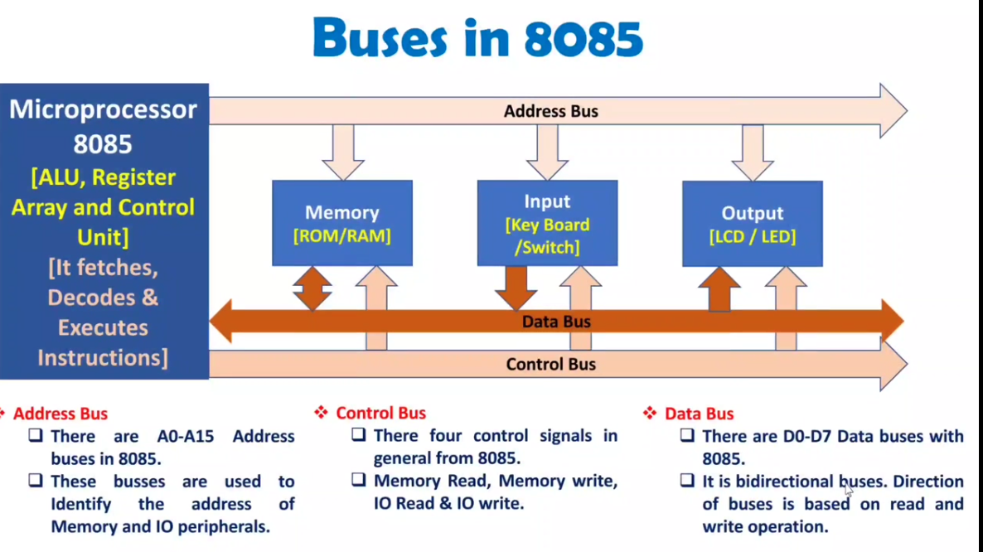
8085 Bus organization
Microprocessor preformed these operations using set of buses: Address bus, data bus and Control bus.
The microprocessor needs to preform the following steps:
  1.Identifiy the peripherals
  2.Transfer data
  3. Provide timing or synchronization signals
Bus Structure in 8085

Slide 20
Address and Data Bus Operations
Address Bus: comprises 8 unidirectional signal lines: A8 to A15.
These lines carry high-order address bits, enabling access to a larger memory space.
Multiplexed Address/Data Bus:
The lower 8 address bits (A0 to A7) are multiplexed with the data bits (D0 to D7) on AD0 to AD7 lines.
These lines are bi-directional, serving dual purposes:
    Carry address bits during the initial phase of instruction execution.
    Carry data bits during the subsequent phase
The high-order address bits (A8 to A15) are stable on the bus for three clock cycles.
The low-order address bits (A0 to A7) are only available for one clock cycle. If not saved, they would be lost
Demultiplexing:
The lower-order address bits are only valid for one clock cycle and must be captured to avoid data loss when the lines switch to carry data.
A latch captures the lower-order address bits during their availability.
Controlled by the clock signal, the latch holds the address while the AD lines transition to data.

Slide 21
cnt
Timing:
Clock Cycle 1: AD0 to AD7 carry the low-order address bits (A0 to A7).
These address bits are placed on the address/data bus during this cycle.
In a multiplexed bus system, a latch captures low-order address bits to separate them from data later
Clock Cycle 2: The high-order address bits (A8 to A15) remain stable on the bus, but the AD lines have already transitioned to carry data bits in a typical multiplexing setup.
Clock Cycle 3: AD0 to AD7 are now carrying the data bits (D0 to D7)
  the multiplexed address/data lines (AD0 to AD7) are now transmitting the actual data bits (D0 to D7) needed for the operation.
  This transition from address to data is a key feature in optimizing the use of bus lines in the system

Slide 22
Microprocessor Operations
The internal logic design of the microprocessor called its architecture, determine how and what various operations are performed by the microprocessor
the function of microprocessor can be classified in three categories
    Microprocessor initiated operation
    Internal data operation
    Peripheral (external initiated) operation
1. Microprocessor initiated operation
Primarily microprocessor performs four operations
  Memory read(read data from memory) →Fetching an instruction to execute.
  Memory write (write data into memory) →Storing the result of calculation
  I/O read (Accept data from input device )
  I/O writes (sends data to output device)

Slide 23
Cntd…
2. Internal Data Operation
The internal architecture of the 8085 microprocessor determines how and what operation can be performed with the data.
These operations are:-
Store 8 bit data
Performing athematic and logical operation
Test for conditions
Sequence of the execution of instructions
Store the data temporarily during execution in the defined R/W memory locations called stack
To perform these operations the microprocessor requires:-
Registers
An arithmetic logic unit (ALU) & control unit
Internal bus (paths for information flow)

Slide 24
3. Peripherals or Externally Initiated Operation
External devices (signals) can initiate the following operations for which individual pins on the microprocessor chip are assigned: Reset, Ready, Interrupt Hold.
Reset: when reset is activated all internal operations are suspended and the program counter is cleared.
Interrupt: the microprocessor can be interrupted from normal execution and asked to execute other instructions called “service routine”(emergency). Microprocessor saves its state and resumes its operations after that.
Ready: 8085 has pin called ready, this signal is used by slower peripheral devices to inform the microprocessor whether they are ready to send or receive data.
  low microprocessor enters into wait state used to synchronized slower peripherals with microprocessor
Hold: when hold pin activated by external signal microprocessor resigns control buses and allows the external peripherals to use the processor
  hold signal is used in direct memory access data transfer.

Slide 25
Timing Diagram and machine cycles of 8085 Microprocessor
Timing Diagram: Timing Diagram is a graphical representation of execution time taken by each instruction in a graphical format.
    The execution time is represented in T-states.
Instruction Cycle: The time required to complete execution of instruction
    Instruction cycle = fetch cycle + execution cycle
Machine Cycle: The time required to complete any operation of accessing from memory or input/output devices is called machine cycle.
    Which is subpart of the instruction
T-State: The machine cycle and instruction cycle takes multiple clock periods.
A portion of an operation carried out in one system clock period is called as T-state.

Slide 26
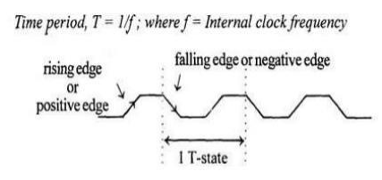
Machine cycles of 8085
The 8085 microprocessor has 5 (five) basic machine cycles.
They are:
Opcode fetch cycle (4T)→from memory
Memory read cycle (3 T)
Memory write cycle (3 T)
I/O read cycle (3 T)
I/O write cycle (3 T)
Interrupt Acknowledge Cycle: Acknowledge and service an interrupt (6 T-states)

Slide 27
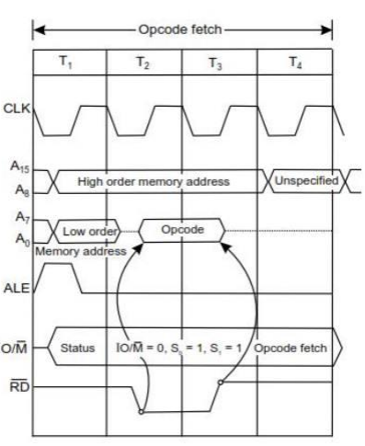
Cntd…
Opcode fetch machine cycle of 8085 :
Fig. Opcode fetch machine Cycle

Slide 28
Cntd…
Each instruction of the processor has one byte opcode.
The opcode are stored in memory. So, the processor executes the opcode fetch machine cycle to fetch the opcode from memory.
Hence, every instruction starts with opcode fetch machine cycle.
The time taken by the processor to execute the opcode fetch cycle is 4T.
In this time, the first, 3 T-states are used for fetching the opcode from memory and the remaining T-states are used for internal operations by the processor.
2.Memory Read Machine Cycle of 8085: The memory read machine cycle is executed by the processor to read a data byte from memory.
The processor takes 3T states to execute this cycle.
The instructions which have more than one byte word size will use the machine cycle after the opcode fetch machine cycle.

Slide 29
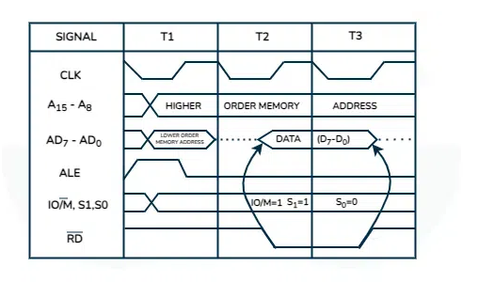
Cntd…
  Fig Memory Read Machine

Slide 30
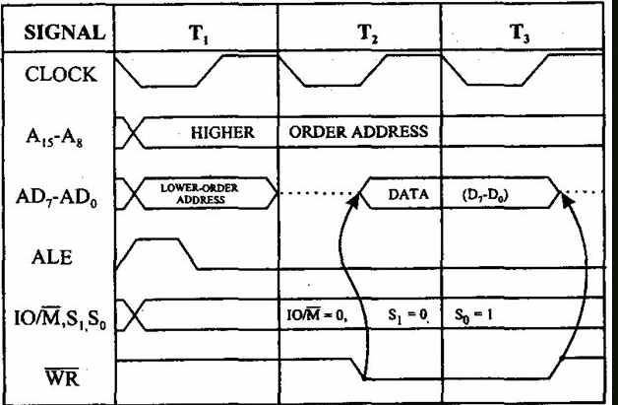
Cntd…
  3. Cycle 3. Memory Write Machine Cycle of 8085
  Fig Memory Write machine cycle
  The memory write machine cycle is executed by the processor to write a data byte in a memory location.
  The processor takes, 3T states to execute this machine cycle.

Slide 31
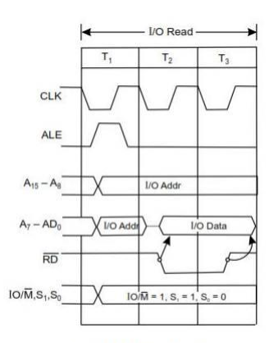
  Cntd…
  4. I/O Read Cycle of 8085
  The I/O Read cycle is executed by the processor to read a data byte from I/O port or from the peripheral, which is I/O, mapped in the system.
  The processor takes 3T states to execute this machine cycle. The IN instruction uses this machine cycle during the execution
  Fig I/O read Cycle

Slide 32
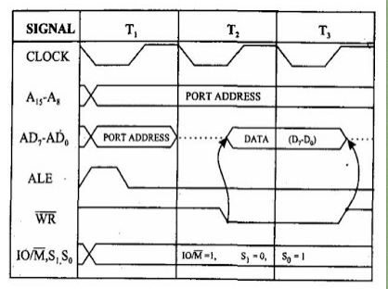
  Cntd…
  4. I/O Write Cycle of 8085
  A writer's I/O cycle is executed by the processor to write a data byte to an I/O port or peripheral that is I/O mapped in the system.
  The processor needs 3T states to execute this machine cycle.
        Fig I/O Write Cycle

Slide 33
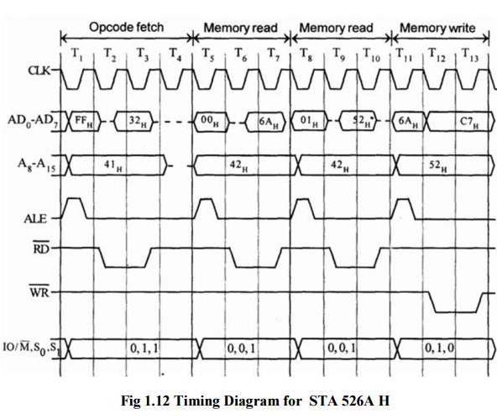
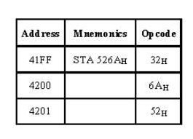
  Cntd…
  Cycle 1.4.2 Timing diagram for STA 526AH

Slide 34
  Cntd…
  STA means Store Accumulator -The contents of the accumulator is stored in the specified address (526A).
  The opcode of the STA instruction is said to be 32H.
  It is fetched from the memory 41FFH (see fig). - OF machine cycle
  Then the lower order memory address is read (6A). - Memory Read Machine Cycle
  Read the higher order memory address (52).- Memory Read Machine Cycle
  The combination of both the addresses are considered and the content from accumulator is written in 526A. - Memory Write Machine Cycle
  Assume the memory address for the instruction and let the content of accumulator is C7H. So,
  C7H from accumulator is now stored in 526A

Slide 35
End of chapter Two
Any question???

